Slide 1
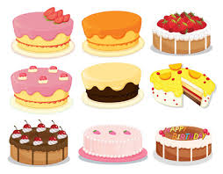
Tom Butler Cup Competition 2022 “Bobbington Bake off”
Bobbington Parish Council
The Chairman and Councillors of Bobbington Parish Council invite you to enter their Jubilee Bake off Competition.
To enter you will need to bake a cake fit for the Queen!
The cake can be of any size including cupcakes and can be decorated
as you see fit for the jubilee.
Age Categories:
0 – 11 years
12 - 17 years
18+ years
Prizes: There will be a prize for the first 3 in each age category. The overall winner will receive the Tom Butler Cup (*)
Entries should be submitted with a list of ingredients / allergens and accompanied by your name, contact number / email and age category.
Cakes should be deposited at Bobbington Village Hall between 11am and 12 noon on Saturday 4th June 2022
Judging (*) will take place on Saturday 4th June 2022 at 12 noon in Bobbington Village Hall – all are welcome to attend
Winners will be announced immediately after the judging and also at Bobbington Bash on Saturday 4th June 2022 at 5:30pm
Judges: Bobbington Bake off will be judged by; Michelle, Pastry Chef at The Red Lion; Sir Gavin Williamson MP; District and County Cllr Victoria Wilson and Cllr Louise Jones, Chairman of Bobbington Parish Council
The Tom Butler Cup remains the property of Bobbington Parish Council and is to be returned after the period of 12 months
The judges decision is final
Entrants permit Bobbington Parish Council to use photographs of the entries for marketing or similar purposes without further authority.

